Slide 1

Heart Disease Prediction System
Using Machine Learning and Streamlit
Presented by: Sumit Kumar Jha
Department: Computer Science & Engineering (CSE) | Section: BCS – 3B
University: Techno India University | IBM - PBEL

Slide 2

Early Prediction: A Lifesaving Approach
Heart disease remains a global health crisis, responsible for a significant number of fatalities worldwide. The ability to predict its onset early can revolutionise preventive healthcare, offering a chance to intervene before it's too late.
This project pioneers a Machine Learning-based system designed to predict the risk of heart disease.
Our intuitive web application allows users to input their medical details and receive instant, crucial prediction results.

Slide 3
Our Vision: Key Objectives
Accurate Predictive Model
Efficient Preprocessing & Training
Interactive Dashboard
To rigorously analyse the heart disease dataset and construct a highly accurate predictive model.
To design a user-friendly and interactive Streamlit dashboard for seamless predictions.
To implement robust data preprocessing and model training techniques using Scikit-learn.
Batch Prediction Capability
Online Accessibility
To deploy the predictive model online, ensuring public access and widespread utility.
To enable batch predictions via CSV uploads, catering to multiple patient analyses simultaneously.

Slide 4

Technology Stack: Powering Our Solution
Python
Scikit-learn
Pandas & NumPy
The core programming language for development.
For machine learning model development and training.
Essential libraries for efficient data processing and manipulation.
Matplotlib
Streamlit
Streamlit Cloud
For powerful data visualization and insights.
For building the intuitive web UI and facilitating deployment.
The platform for seamless online deployment.
Git & GitHub
For robust version control and collaborative development.

Slide 5
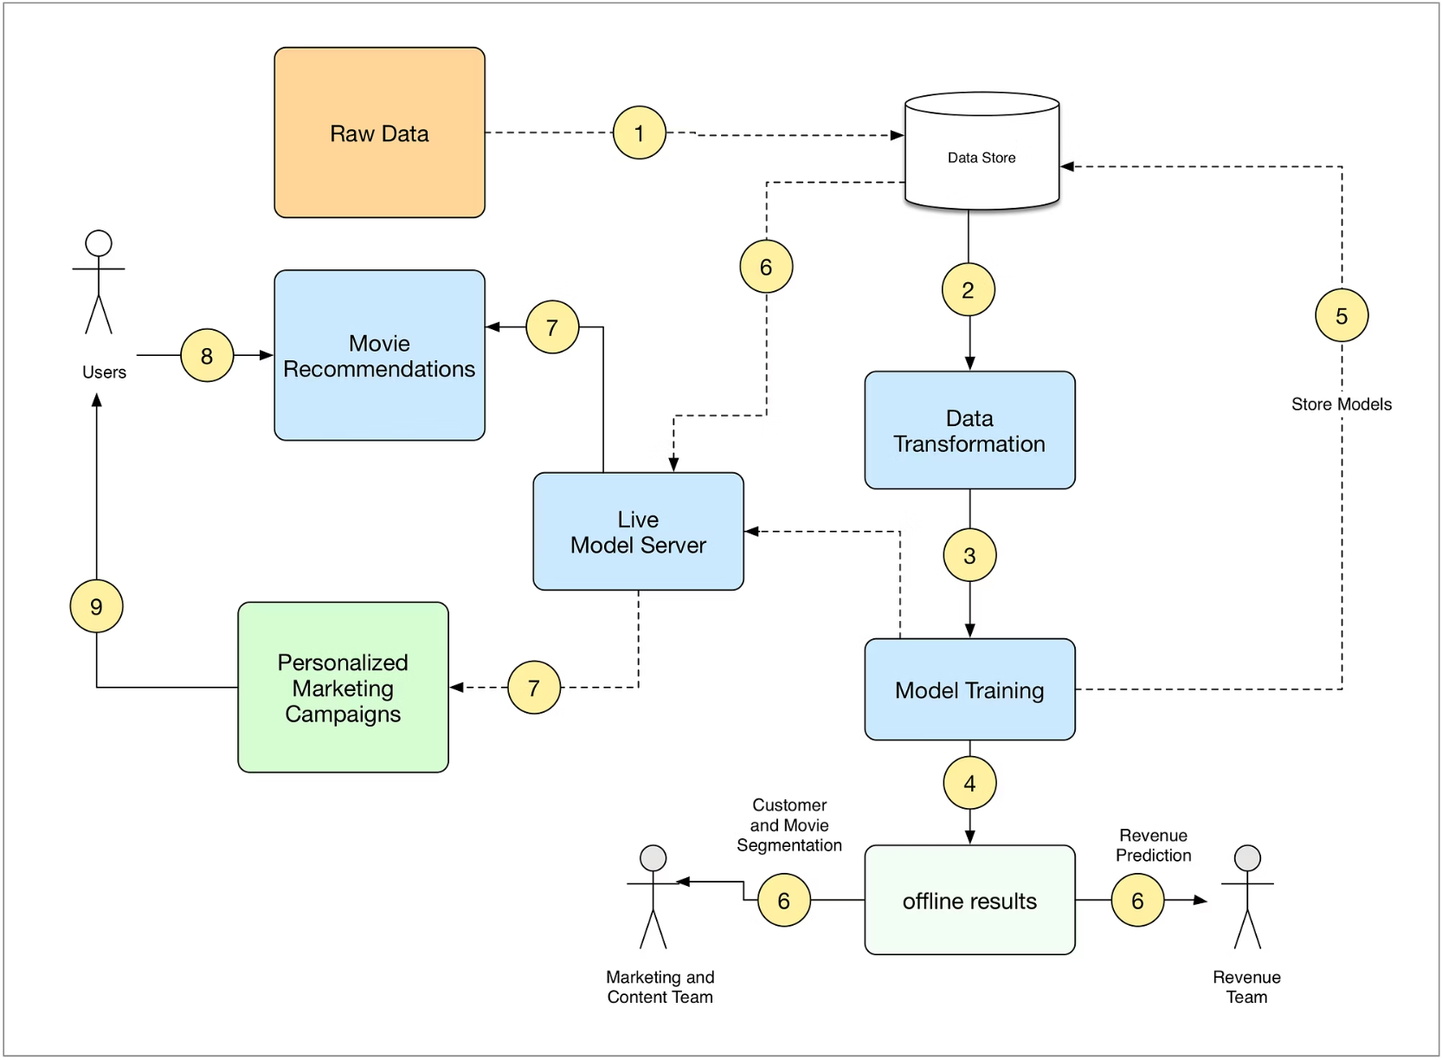
Implementation Deep Dive: The Engine Behind Prediction
Algorithm: Logistic Regression – chosen for its interpretability and efficiency in binary classification.
Dataset: HeartDiseaseTrain-Test.csv – a comprehensive dataset crucial for model training.
Feature Types: A blend of numeric (Age, RestingBP, Cholesterol, MaxHR, etc.) and categorical (Sex, ChestPainType, ST_Slope, etc.) attributes.
Preprocessing: Utilising ColumnTransformer with StandardScaler for numerical features and OneHotEncoder for categorical features, ensuring data readiness.
Accuracy Achieved: An impressive ~88.6%, demonstrating the model's reliability.
Output: Clear risk classification – Heart Disease or No Heart Disease.

Slide 6

System Architecture: From Data to Decision
Dataset
Data Preprocessing
Model Training
Model Evaluation
Layered Approach for Robustness:
Data Layer
Model Layer
UI Layer
Handles dataset acquisition, cleaning, and preparation.
Encompasses ML pipeline creation, training, and evaluation.
The interactive Streamlit web application for user interaction.

Slide 7
Overcoming Obstacles: Challenges & Solutions
Initial low model accuracy
Fine-tuned preprocessing, feature scaling, and hyperparameter optimisation.
Numeric-only inputs in UI
Implemented intuitive dropdowns for categorical fields to enhance user experience.
CSS inconsistencies in Streamlit
Applied a custom HTML/CSS theme to ensure a consistent and professional medical UI.
File path issues during deployment
Utilised relative paths and comprehensive error handling for seamless deployment.
Deployment errors and dependencies
Resolved dependency conflicts and leveraged the robust Streamlit Cloud platform.

Slide 8

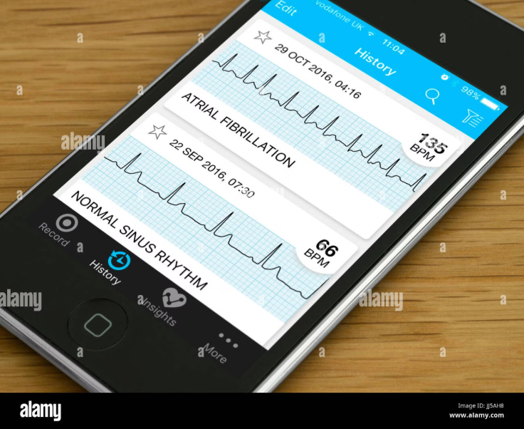
Impact & Accessibility: Results & Deployment
Achieved Accuracy: A robust 88.6% ensures high confidence in predictions.
User Interface: Features a modern Red-White medical theme, designed for clarity and ease of use.
Live Web App: Access the Heart Disease Predictor online for real-time assessments.
Key Outputs:
Displays precise disease risk probability.
Provides insightful visual charts for enhanced understanding.
Supports both single patient and batch predictions for greater utility.

